Slide 1
Marketing Scorecard
Andrew Dod
Chief Marketing Officer
404-432-7211
andrew@qmarq.com

Slide 2
A View to Execution
What MUST each of us individually and collectively as a group do differently tomorrow to generate ever-increasing exceptional results?
XYZ’s Potential Results by the end of 2025s
Behavioral change happens here
Financial Performance
XYZ’s Current Projected Results
XYZ’s Business
as Usual
Time

Slide 3
Accountability Cascade
Mission
Why we exist and for what purpose
Vision
Values
Brand
Business Plan
How we will market
Marketing Strategy and Plan
Marketing Initiatives
Major Action Items
What we will do (and NOT do)
Milestones
Team KPIs/Financials
By what means will we measure our progress
Individual KPIs/Financials

Slide 4
Marketing Change Agenda
As is
To be by end of 2025
Strategy
Brand and Awareness
Lead Generation
Empathy and Nurture
Business Development
Post Sale Engagement
Brand Champions

Slide 5
XYZ Marketing Strategy Map
“Driving high-impact brand and marketing initiatives that generate enormous awareness, clear preference, increased demand and fierce loyalty for XYZ.”
V1. XYZ is ___________________________
Value
V1a. Deliver _______________________
V1b. Achieve ________________________
Brand Awareness
Lead Generation
Empathy/Nurture
Business Development
Post-Sale Engagement
Champion Converts
C1. “I recognize XYZ’s ___________.”
C2. “XYZ’s services _____________”
C3. “XYZ gets _______________”
C4. “Before and after the sale, XYZ ______________”
C5. “I am XYZ’s Champion to ____________.”
Customers
Suspects
Leads
Customers
Champions
Unique and Integrated Value proposition to our Customers
Intuitively designed - Profoundly powerful - Simply managed - Eminently affordable
P1. Embrace a unified brand throughout all communications and push creative boundaries
P4. Establish and maintain a diversified lead generation program that attracts high quality leads
P7. Tune on analytics dashboards to enable data-powered learnings
Processes
P2. Develop rich, content for each stage of the buying cycle around a focused editorial calendar.
P5. Enhance and extend content syndication initiatives (Social, blogs) to maximize exposure
P8. Establish a flexible budgeting process for agile marketing management
P3. Position the brand in select high impact channels (events, conferences, media, influencers)
P6. Develop a scalable program for converting MQLs to SQLs
P9. Evaluate growth markets and opportunities and embrace testing
E1. Build or hire the skills necessary to achieve our strategy
E2. Partner with IT to support marketing initiatives and data collection
E3. Secure and steward marketing resources and spend wisely
Enablers
OUR VALUES - OUR CULTURE - OUR BRAND
Insurgent Empathetic Transparent Engaging Humble Fun
7
7

Slide 6
Strategy map objective definitions
(Customer Perspective)
Why? | What? | How = Potential Initiatives
C1.
C2.
C3.
C4.
C5.

Slide 7
Strategy map objective definitions
(Process Perspective)
Why? | What? | How = Potential Initiatives
P1.
P2.
P3.
P4.
P5.
P6.
P7.
P8.
P9.

Slide 8
Strategy map objective definitions
(Enabler Perspective)
Why? | What? | How = Potential Initiatives
E1.
E2.
E3.

Slide 9
Initiative prioritization
INSTRUCTIONS:
Please evaluate each balanced scorecard initiative in terms of the 4 variables mentioned below. Each variable should be rated from 1 to 4. An initiative with high strategic relevance and high delivery capacity is ideal. Initiatives with the lowest score represent the highest priorities.
Decide if some initiatives can be discarded
STRATEGIC RELEVANCE
DELIVERY CAPACITY
Criteria
Strategic impact
Urgency
Complexity (interdependencies)
Resource Intensity (resources & capabilities)
The importance/ contribution of an initiative to achieve desired strategic outcomes
How fast this initiative needs to be implemented in order to achieve desired outcomes
Initiatives that affect all (or most of) the departments and require high degree of partnerships must be highly rated.
Does the organization have the capabilities, skills and resources to deliver within planning? Initiatives requiring high resource intensity must be highly rated.
Definition

Slide 10
INSTRUCTIONS:
Please fill in this template for each initiative from the Marketing Scorecard
Initiative cards
Initiative
Name
Description
In 100 words or less
Owner
Involvement from other parts of the business
Name
In 50 words of less
Strategy Objectives
Strategic Impact
Urgency
Budget
Start - End
Primary: xx
Secondary: xx
High/ middle/ low
Short/ middle/ long
xx
xx – xx
Main activities | Start (plan/actual) | End (plan/ actual) | Milestone | Additional Budget
xxx | xx | xx | xx | xx
xxx | xx | xx | xx | xx
xxx | xx | xx | xx | xx

Slide 11
Team KPIs
KPIs (Typically, 2-4 for each) | Base | Stretch | Reach
P1.
P2.
P3.
P4.
P5.
P6.
P7.
P8.
P9.

Slide 12
Individual KPIs
KPIs | Base | Stretch | Reach

Slide 13
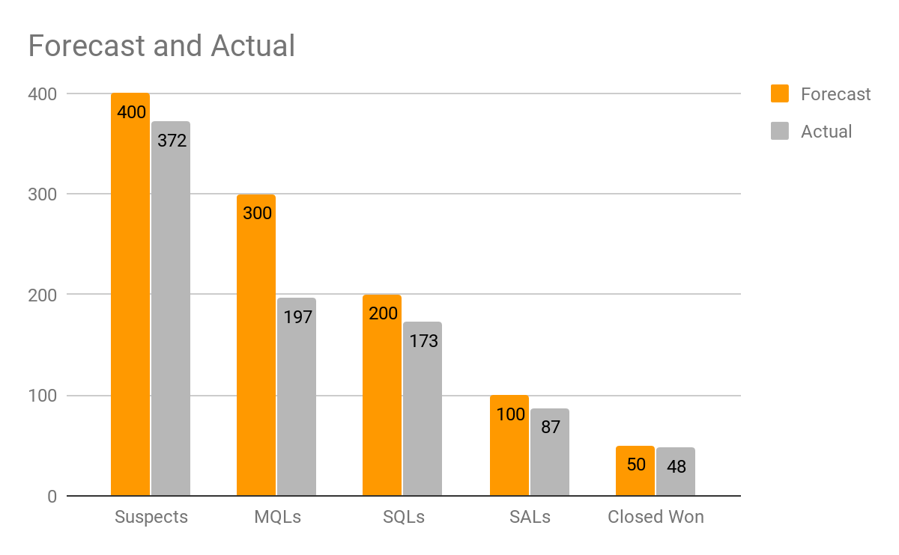
Weekly/Monthly Projections/Results
 | Forecast | Actual | % Variance
Suspects | 400 | 372 | 93.00%
MQLs | 300 | 197 | 65.67%
SQLs | 200 | 173 | 86.50%
SALs | 100 | 87 | 87.00%
Closed Won | 50 | 48 | 96.00%
Key Learnings
What do we see inside the results above? What’s working well, and what isn’t?:
3. Dependencies:
Based on the recommendations, are there any key dependencies, e.g. IT team involvement, additional budget?
2. Recommendations:
What changes do we need to make?
4. Impact:
What do we believe will happen by implementing the recommendations?

